Slide 1
Elements and
Atoms
Basic Chemistry:

Slide 2
I. ELEMENTS & ATOMS:
Matter = Anything that takes up space and has mass
Element = A substance that cannot be broken down into simpler substances
  Periodic Table – lists all known elements
    1-92 occur in nature (natural elements)
    93 and above are synthetic (man-made)
Element names are abbreviated using chemical symbols (N, C, Ca, Fe, Cl)

Slide 3
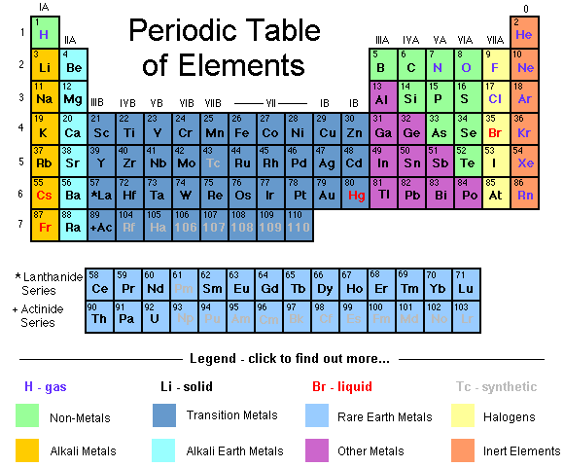

Slide 4

Natural elements
  25 are essential to living things
  Carbon (C), Hydrogen (H), Oxygen (O), Nitrogen (N), make up 96% of human mass

Slide 5
Trace elements
  Found in very small amounts but are essential to proper cellular activities
    Ex: iron, magnesium, iodine

Slide 6
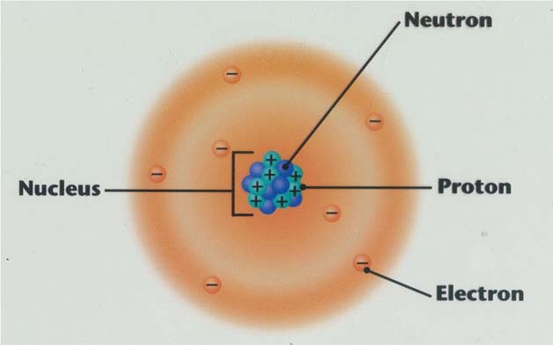
ATOMS = Basic Building Blocks of all matter.
  Smallest particle of an element that has the characteristics of that element
Nitrogen Atom

Slide 7
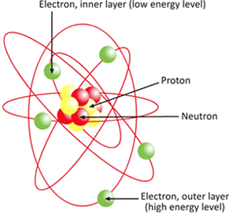
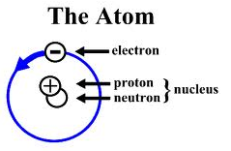
3 Subatomic particles make up an atom:
1. Protons (P) = positively charged particles. In the nucleus
2. Neutrons (N) = no charge (neutral), In the nucleus
3. Electrons (e-) = (negative charge. Outside the nucleus

Slide 8
  2 parts of an atom:
1. Nucleus = Center of atom; contains protons & neutrons
2. Electron cloud/energy levels – around the nucleus
Nitrogen Atom

Slide 9
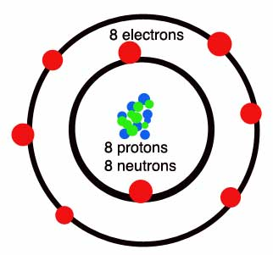
  Atoms contain an equal number of protons and electrons so the overall charge of an atom is zero.
Oxygen Atom

Slide 10
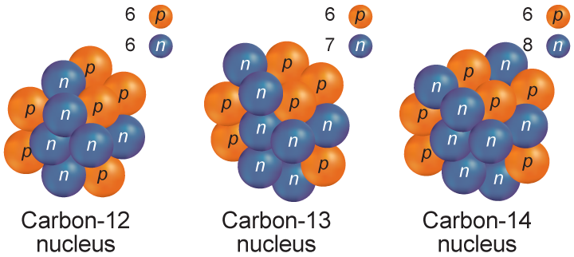
II. ISOTOPES:
Isotopes = Atoms of the same element that have different numbers of neutrons

Slide 11
II. ISOTOPES:
  Named by their mass numbers
    C-12 = (6 N + 6 P)
    C-13 = (7 N + 6 P)
    C-14= (8 N + 6 P) → Radioactive (nuclei break apart)
      Used in the medical field

Slide 12

III.ATOMIC NUMBER & MASS NUMBER:
Atomic Number = number of protons and/or electrons of an atom
  Ex: Na-23 contains 11 electrons and 11 protons
Mass Number = the sum of protons and neutrons of an atom
  Mass Number = # of protons (P) + # of neutrons (N)

Slide 13
IV.ENERGY LEVELS & DIAGRAMING ATOMS:
Energy levels = regions around the nucleus where electrons travel. Also known as electron shells.
  1st energy level can only have 2 electrons
Octet Rule = Each energy level after the first can have up to 8 electrons

Slide 14
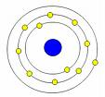
What atom is represented in this picture?
How do you know?
Sodium (Na)
Sodium’s atomic number is 11 so it has 11 e-

Slide 15
Ex: Helium (He)
Atomic # = 2; Mass # = 3
2e-
2P
1N
Nucleus

Slide 16
Ex: Chlorine (Cl)
Atomic # = 17; Mass # = 35
7e-
8e-
17 P
18 N
2e-

Slide 17
Ex: Carbon (C)
Atomic # = 6; Mass # = 14
4e-
6P
8N
2e-

Slide 18
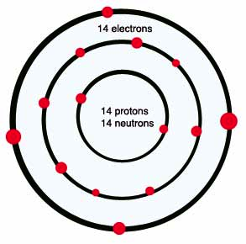
What are Valence Electrons?
The electrons in an atom’s outmost shell
Outer most shell is also known as the valence shell

Slide 19
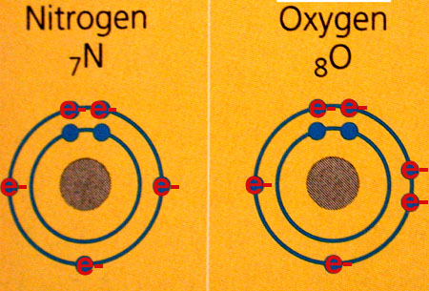
I. COMPOUNDS & BONDING:
Compound = a substance made of chemically combined elements.
Atoms bond to form stable compounds
  Atoms need 8 e- in outer energy level to be stable;
    Exception: hydrogen needs 2 e-
Open bonding sites
(electrons) encourage
bonding

Slide 20
I. COMPOUNDS & BONDING:
Elements can combine in two ways:
1. Covalent Bonding:
  Covalent bonds SHARE electrons to fill their outer energy level
    The positively charged nucleus is attracted to the negatively charged electrons
  Water, sugars, fats, and proteins are covalent molecules

Slide 21
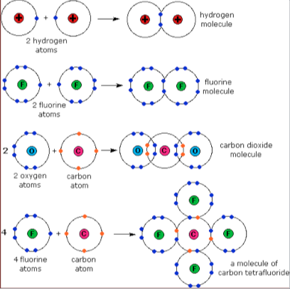
Examples of Covalent Bonding

Slide 22
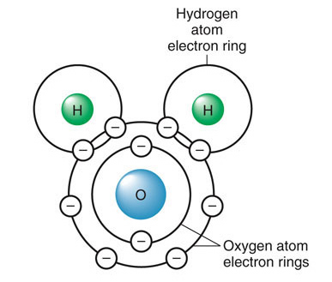
I. COMPOUNDS & BONDING:
  Molecule = a group of covalently bonded atoms with no charge
    Ex: H₂O → 2 hydrogen atoms + 1 oxygen atom
- Oxygen needs two electrons to become stable
- Each hydrogen needs 1 electron to fill orbital
Therefore, they SHARE!!

Slide 23
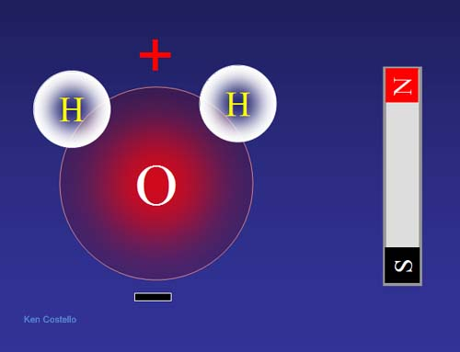
II. POLAR Covalent Bonds
Polar = unequal distribution of charge
Each molecule has a positive end and a negative end

Slide 24
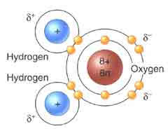
II. WATER IS POLAR
Ex: Water (H₂O) molecule --> Oxygen is much stronger and therefore has a stronger negative charge than the hydrogen’s positive charge

Slide 25
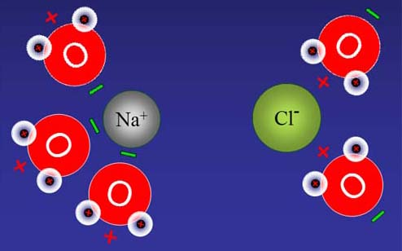
II. WATER IS POLAR
Because of water’s polarity, it can dissolve many ionic compounds and other polar compounds such as sugars
Water Dissolving an Ionic Compound- NaCl (table salt)

Slide 26
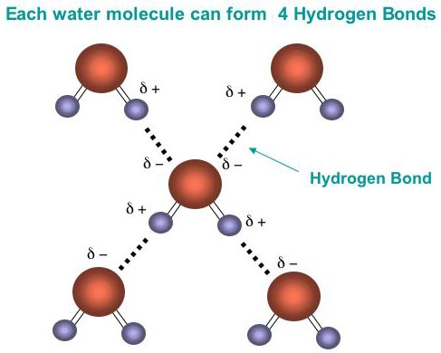
II. WATER IS POLAR
The water molecules also adhere to each other because of polarity (unequal distribution of charge)
The attraction of opposite charges forms a weak bond called a hydrogen bond
  This keeps large molecules together! (Ex: proteins)

Slide 27
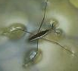
III. UNIQUENESS OF WATER- due to its polarity!
1. Cohesion = the attraction between like molecules
Surface tension results from the cohesive properties of water.
The polarity of water cause the surface layer of water molecules to act like a stretched film over the surface of the water (surface tension)
  Ex: water striders

Slide 28
III. UNIQUENESS OF WATER- due to its polarity!
2. Creeps up in thin tubes (Capillary action)
The polarity of water allows plants to get water from the ground
  Water creeps up tubes in plant roots and stems

Slide 29
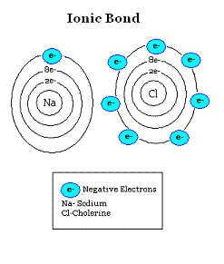
I. COMPOUNDS & BONDING:
2. Ionic Bonding:
  Transfer of electrons creating ions that attract each other = Ionic Bond

Slide 30
Ionic Bonding:
  Ions = charged atoms because they have gained or lost electron(s)
    Cations - Atoms that lose electrons become more positive
    Anions- Atoms that gain electrons become more negative
    Atoms gain/lose electrons efficiently

Slide 31
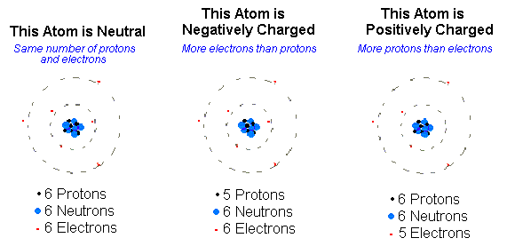

Slide 32
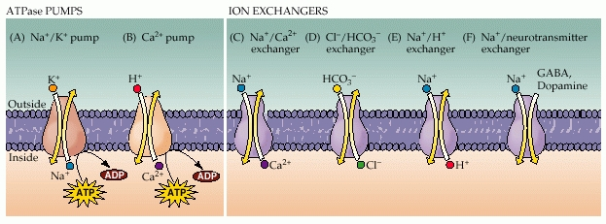
Ions in living things:
  Include- sodium, potassium, calcium, chloride, carbonate ions
  Help maintain homeostasis as these ions travel in and out of cells
  Help transmit signals among cells that allow you to see, taste, hear, feel, and smell

Slide 33
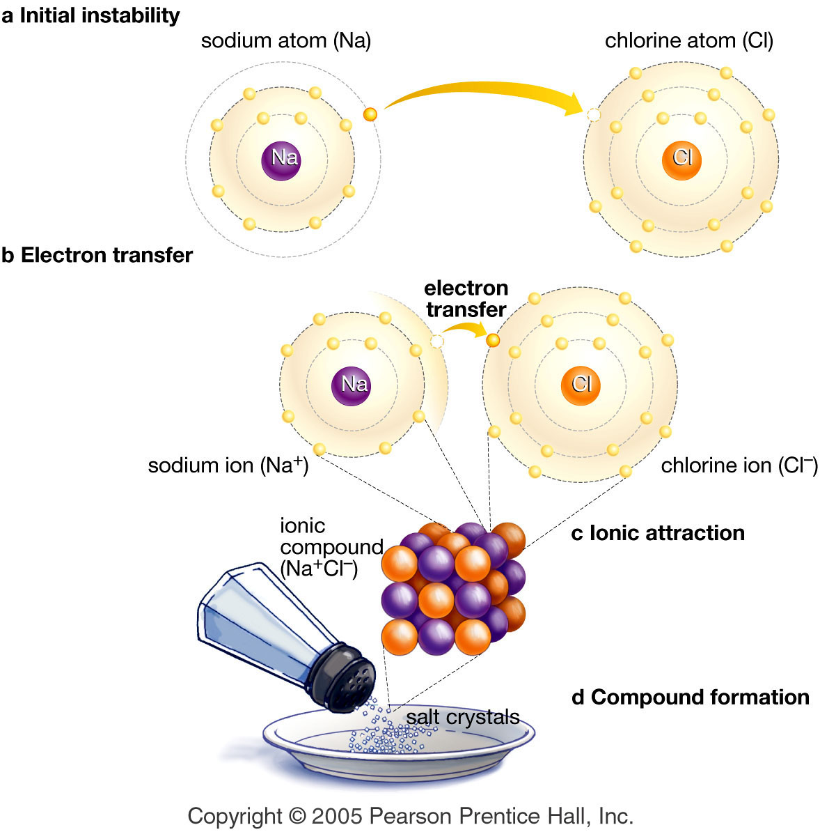
Na (11)
11⁺
+11e⁻
0
Cl (17)
17⁺
+17e⁻
0
Cl gains 1e-
17⁺
+18e⁻
⁻1 ION
Na loses 1e-
11⁺
+10e⁻
⁺1 ION
Na⁺¹ + Cl⁻¹ --> NaCl

Slide 34
Dissecting an Element:
In a neutral atom the following is true:
Number of Protons = Atomic Number
Number of Electrons = Atomic Number**
Number of Neutrons + Number of Protons = Atomic Mass**
Number of Neutrons = Mass Number - Atomic Number
For Krypton:
Number of Protons = Atomic Number = 36
Number of Electrons= Atomic Number = 36
Number of Neutrons = Mass Number-Atomic Number: 84 - 36 = 48

Slide 35
Ions
An ion is an atom with a positive or negative charge. This means
it has either more or less electrons than protons.
Kr+ is a positively charged Krypton ion
It lost an electron to become positive
It has 36 protons, and 35 electrons
Kr- is a negatively charged Krypton ion
It gained an electron to become negative
It has 36 protons and 37 electrons
Finding Valence Electrons in an ion:
If it positive subtract 1 electron from which column its in
If it is negative add 1 electron

Slide 36
Ion Practice
Mg-
Atomic number =
Mass number=
Protons =
Electrons =
Neutrons=
Valence electrons=

