Slide 1
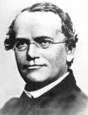
Mendelian Genetics

Slide 2
Genetic Terminology:
Trait = any characteristic that can be passed from parent to offspring
Heredity = passing of traits from parent to offspring
Genetics = study of heredity

Slide 3
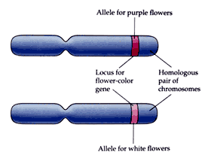
Genetic Terminology:
Alleles = two forms of a gene (dominant & recessive)

Slide 4
Genetic Terminology:
Dominant = stronger of two genes expressed in the hybrid; represented by a capital letter (R)
Recessive = gene that shows up less often in a cross; represented by a lowercase letter (r)

Slide 5
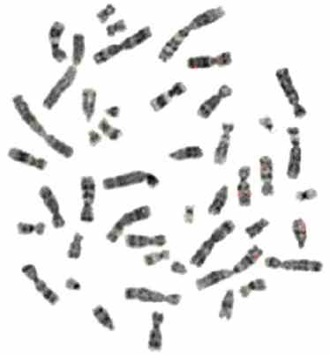
Genetic Terminology:
Genotype = gene combination for a trait (ex: RR, Rr, rr)
Phenotype = the physical feature resulting from a genotype (e.g. tall, short)

Slide 6
Genetic Terminology:
Homozygous genotype = gene combination involving 2 dominant or 2 recessive genes (ex: RR or rr); also called pure
Heterozygous genotype = gene combination of one dominant & one recessive allele (ex: Rr); also called hybrid

Slide 7
Genetic Terminology:
Monohybrid cross = cross involving a single trait
Dihybrid cross = cross involving two traits

Slide 8
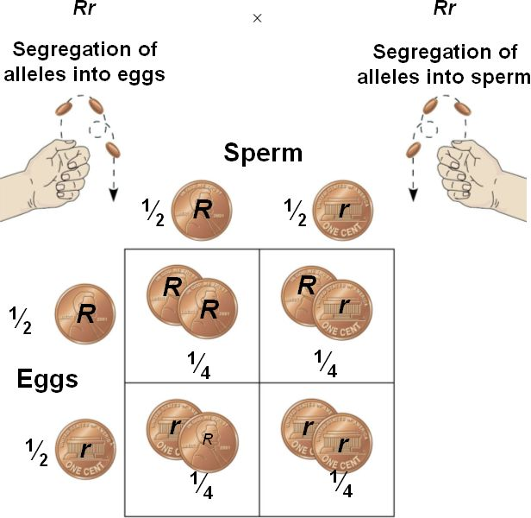
Genetic Terminology:
Punnett Square = used to solve genetics problems. (based on probability)

Slide 9
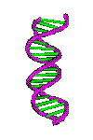
FUNDAMENTALS OF GENETICS
HEREDITY = The passing of traits from parents to offspring.
      Transmitted by means of information stored in molecules of DNA.

Slide 10
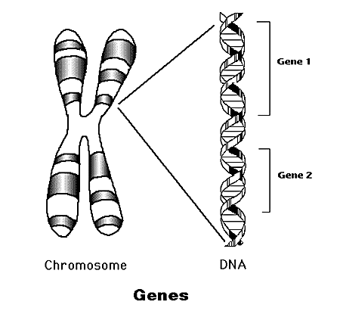
FUNDAMENTALS OF GENETICS
GENETCS is based on knowledge that traits are transmitted by chromosomes, which are made up of genes.
Genes, are pieces of DNA that code for certain traits.

Slide 11
WHAT MAKES YOU WHO YOU ARE TODAY?
HEREDITY & ENVIRONMENT--are the two great influences, acting together all through your life.
Genetic messages determine what organisms may become.
The interaction of messages and the environment determines what organisms do become.

Slide 12

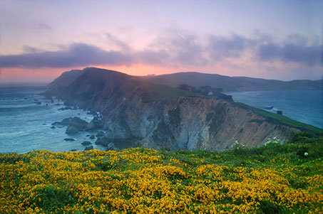
FUNDAMENTALS OF GENETICS
ENVIRONMENT = All the outside forces that act on an organism.
    Affects the development, later life, and the expression of hereditary traits of an organism.

Slide 13
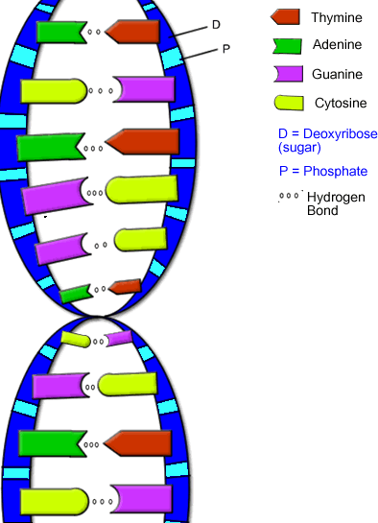
Organisms inherit genetic messages, not traits!
Traits develop when genetic messages interact with the environment.

Slide 14
Gregor Mendel
GREGOR MENDEL -“Father of Genetics” – (1865) Austrian monk
    His research with garden peas (8 yrs) led to the discovery of the basic principles of heredity.

Slide 15
Gregor Mendel
studied pea traits, each of which had a dominant & a recessive form (alleles).
The dominant gene or allele is represented with a capital letter (ex: B)
recessive gene represented with a lower case of that same letter (ex: b)

Slide 16
Gregor Mendel
Mendel's traits included:
a. Seed shape --- Round (R) or Wrinkled (r)
b. Seed Color ---- Yellow (Y) or Green (y)
c. Pod Shape --- Smooth (S) or wrinkled (s)
d. Pod Color --- Green (G) or Yellow (g)
e. Seed Coat Color --- Gray (G) or White (g)
f. Plant Height --- Tall (T) or Short (t)
g. Flower color --- Purple (P) or white (p)

Slide 17
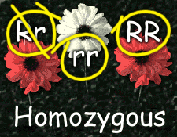
MENDELIAN GENETICS OVERVIEW
    If both of our parents gave us the same type of gene – the same allele – then we are:
    HOMOZYGOUS or pure (on both sets of our chromosomes, on both sets of genes; the allele is the same).

Slide 18
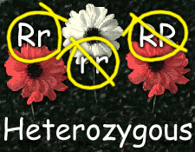
MENDELIAN GENETICS OVERVIEW
If one parent gave us one type of gene and the other parent gave us a different type, then we are:
    HETEROZYGOUS or hybrid – we have two different alleles.

Slide 19
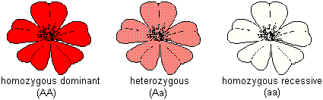
MENDELIAN GENETICS OVERVIEW
With MENDELIAN traits (the type of traits that Mendel studied) heterozygotes DO NOT have a blend of the two alleles.
    Instead, one type of allele dominates and we show the characteristics of this allele only – it is the DOMINANT trait.

Slide 20
MENDELIAN GENETICS OVERVIEW
      The recessive gene is still there on half of our chromosomes
        It can still pass to our children, depending on meiosis
        BUT it DOES NOT affect us right now—it is the RECESSIVE trait.

Slide 21
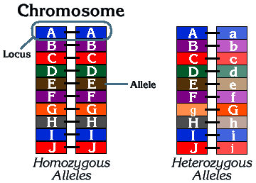

Slide 22
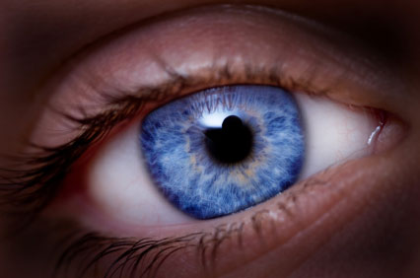
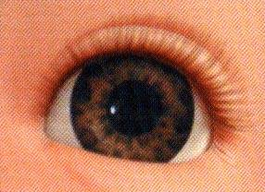
MENDELIAN GENETICS OVERVIEW
GENOTYPE (type of genes that we have)
PHENOTYPE trait we physically show (the type of allele that is expressed)
    For example, if the dominant allele of the eye color gene is brown and the recessive allele of the eye color gene is blue, then the person could have the following possibilities:

Slide 23
MENDELIAN GENETICS OVERVIEW
1. Two blue alleles, bb (one from mom, one from dad).
  Genotype would be ___________________
  Phenotype would be __________________
homozygous recessive
blue-eyed.

Slide 24
MENDELIAN GENETICS OVERVIEW
2. Two brown alleles, BB (one from mom, one from dad).
  Genotype would be ___________________
  Phenotype would be___________________
homozygous dominant
brown-eyed.

Slide 25
MENDELIAN GENETICS OVERVIEW
3. One brown and one blue allele, Bb (one from mom, one from dad).
  Genotype would be ____________________
  Phenotype would be___________________
Heterozygous
brown-eyed.

Slide 26
MENDELIAN GENETICS OVERVIEW
When only one trait is being studied in a genetic cross, it is called a monohybrid cross.
  When parent organisms, called the P generation, are crossed, the resulting offspring are the first filial, or F₁ generation.
  When organisms of the F1 generation are crossed, their offspring make up the second filial or, F₂ generation.

Slide 27
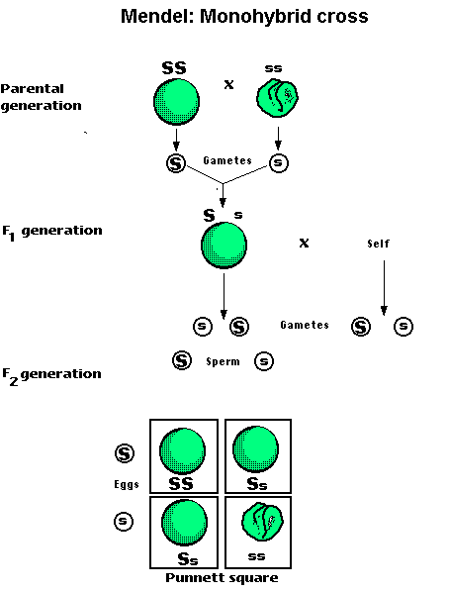

Slide 28
Mendel’s Experiments:
Mendel cross-pollinated two strains and tracked each trait through two generations. (ex: TT x tt )
        Trait = plant height
        Alleles = T (tall), t (short)

Slide 29
Mendel’s Experiments:
P₁ cross = TT x tt
T T
F₁ Genotypic ratio = 100% Tt
F₁ Phenotypic ratio = 100% Tall
t
t
Tt | Tt
Tt | Tt

Slide 30
Mendel’s Experiments:
The offspring of this cross were all hybrids showing only the dominant trait & were called the First Filial or F₁ generation.
T T
t
t
Tt | Tt
Tt | Tt

Slide 31
Mendel’s Experiments:
Mendel then crossed two of his F₁ plants and tracked their traits; known as an F₁ cross.
    Trait = plant height
    Alleles = T (tall), t (short)

Slide 32
Mendel’s Experiments:
F₁ cross = Tt x Tt
          T t
F₂ Genotypic ratio = 1 TT: 2 Tt: 1 tt
F₂ Phenotypic ratio = 3 Tall: 1 short
T
t
TT | Tt
Tt | tt

Slide 33
Mendel’s Experiments:
When 2 hybrids were crossed, 75% (3/4) of the offspring showed the dominant trait & 25% (1/4) showed the recessive trait
Two hybrids always create a 3 (dominant trait): 1 (recessive trait) ratio.
The offspring of this cross were called the F₂ generation.

Slide 34
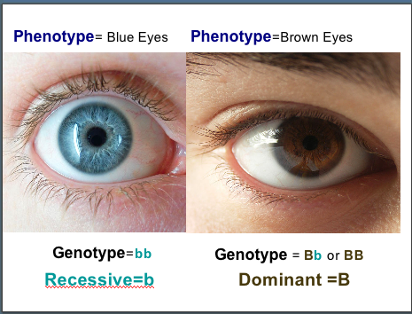
Results of Mendel’s Experiments:
Inheritable factors or genes are responsible for all heritable characteristics.
Phenotype is based on genotype.

Slide 35
Results of Mendel’s Experiments:
Each trait is based on two genes, one from the mother and the other from the father.
True-breeding individuals are homozygous (both alleles) are the same.
Formulated 3 laws of heredity in the early 1860's.

Slide 36
MENDEL’S 3 LAWS OF HEREDITY:
1. Law of Dominance states that when different alleles for a characteristic are inherited (heterozygous), the trait of only one (the dominant one) will be expressed. The recessive trait's phenotype only appears in true-breeding (homozygous) individuals.

Slide 37
Law of Dominance

Slide 38
2. The Law of Segregation = states that each genetic trait is produced by a pair of alleles which separate (segregate) during reproduction.
                Rr
                R r
    Explains the disappearance of a specific trait in the F₁ generation and its reappearance in the F₂ generation.

Slide 39
3. The Law of Independent Assortment = states that each factor (gene) is distributed (assorted) randomly and independently of one another in the formation of gametes (egg or sperm).

Slide 40
The Law of Independent Assortment
Explains that different traits are inherited independently, if on different chromosomes
Ex: wrinkled seeds do not have to be yellow. They can be green.

Slide 41
The Law of Independent Assortment
Ex: A gamete with RrYy
  R and r – separate into different gametes
  Y and y – Separate into different gametes
  They can then recombine 4 ways to form gametes:
RY Ry rY ry

Slide 42
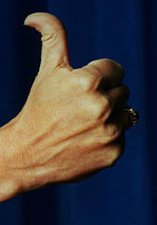
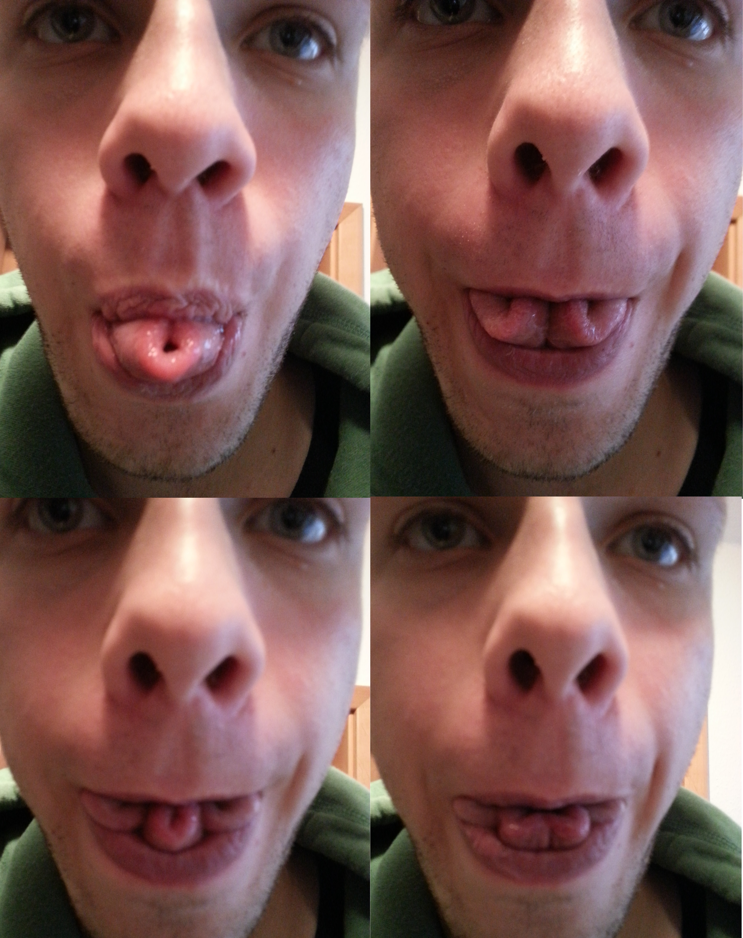
INHERITANCE OF HUMAN TRAITS:
DOMINANT/ RECESSIVE
No cleft in chin / Cleft in chin recessive
Straight thumb / Hitch-hiker’s thumb
Hair on back of hand / no hair on back of hand
Inability to fold tongue/ ability to fold tongue
Tongue roller/ Non-roller
Hitch-hiker’s thumb

Slide 43
INHERITANCE OF HUMAN TRAITS:
DOMINANT/ RECESSIVE
Dark hair/ Light hair
Non-red hair/ Red hair
Widows peak/ Straight or curved hairline
White forelock/ Normal hair
Freckles/ Normal
Dimples/ No dimples

Slide 44
INHERITANCE OF HUMAN TRAITS:
DOMINANT/ RECESSIVE
Brown eyes/ Blue eyes
Normal eyesight/ Nearsighted
Almond shaped eyes/ Round eyes
Long eyelashes/ Short eyelashes
Broad nostrils/ Narrow nostrils
Roman nose/ Straight nose

Slide 45
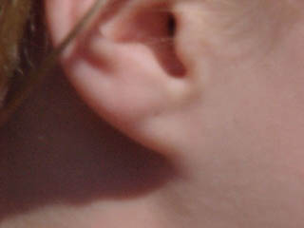
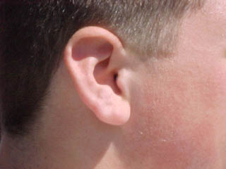
INHERITANCE OF HUMAN TRAITS:
DOMINANT/ RECESSIVE
Free ear lobe/ Attached ear lobe
Bent little fingers/ Parallel little fingers
Left over right thumb/ Right over left thumb
Attached earlobe
Unattached earlobe

Slide 46
INHERITANCE OF HUMAN TRAITS:
DOMINANT/ RECESSIVE
A or B blood/ O blood
RH+ blood/ RH- blood
Normal clotting/ Hemophilia
Normal / Allergy

Slide 47
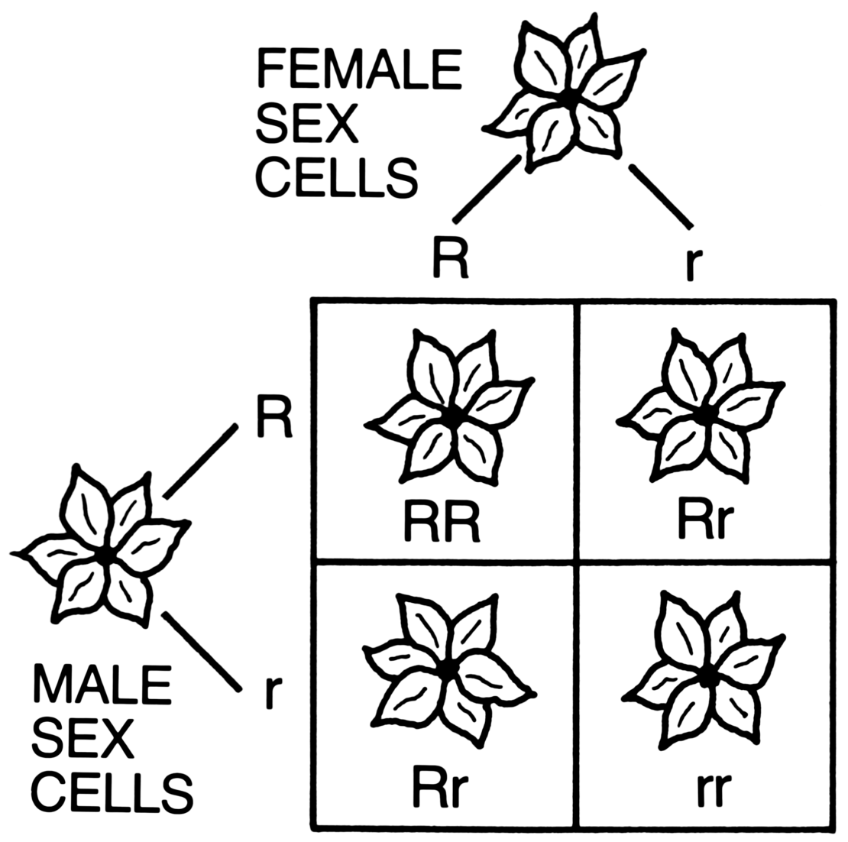
Punnett Squares
Use Punnett Squares to solve genetic problems!

Slide 48
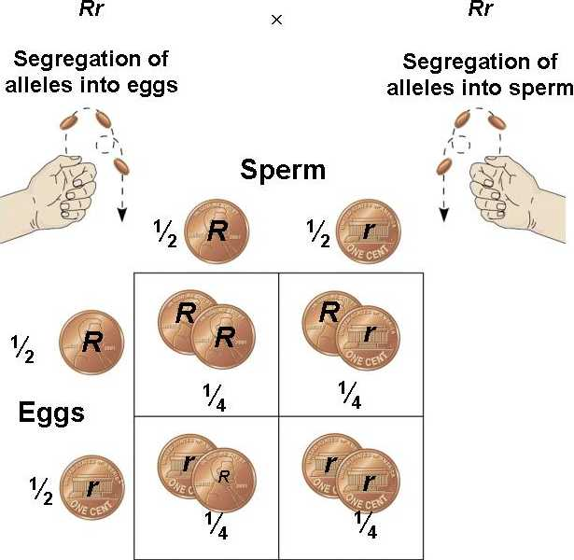
Punnett Squares:
Ex: Crossing two heterozygous genotypes (Rr x Rr)

Slide 49
Punnett Squares:
Remember the letters of a genotype (R, r’s) represent possible gamete (egg/sperm) combinations.

Slide 50
Test Cross Punnett Square:
If an organism shows the dominant trait, you can’t tell if it is heterozygous (Rr) or homozygous(RR) for that trait
To determine the genotype of that organimism a test cross would be done.
Test cross = the organism of unknown dominant genotype is crossed with a homozygous recessive (rr) organism.

Slide 51
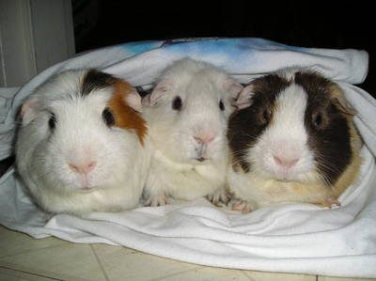
IN CLASS PRACTICE PROBLEMS – MONOHYBRIDS (one trait)
Black coat color in guinea pigs is dominant over white coat color.
Using a Punnett square, show the results of crossing a hybrid black with pure white. Then show the results of crossing a hybrid black and a hybrid black.

Slide 52
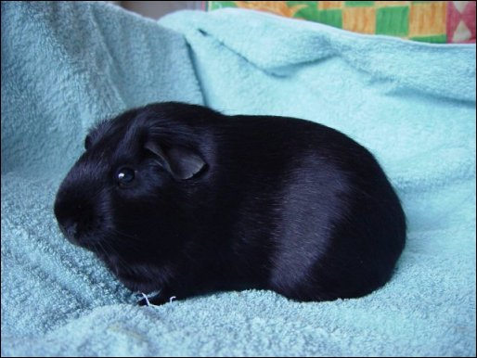
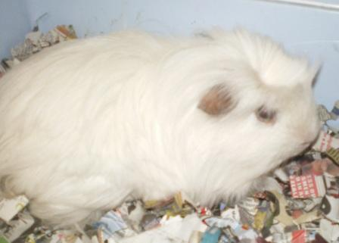
IN CLASS PRACTICE PROBLEMS – MONOHYBRIDS (one trait)
Black Trait – B (dominant)
White Trait – b (recessive)
Hybrid black – Bb
Pure white – bb

Slide 53
IN CLASS PRACTICE PROBLEMS – MONOHYBRIDS (one trait)
P₁ cross: Bb x bb
  B b
Genotypes of F₁ offspring
2 Bb : 2 bb
Phenotypes of F₁ offspring–
2 black : 2 white
(or 50% black and 50% white)
Bb | bb
Bb | bb
b
b

Slide 54
IN CLASS PRACTICE PROBLEMS – MONOHYBRIDS (one trait)
B (dominant)
Black Trait – ____________
White Trait – ____________
Hybrid black – _______
Hybrid black – ________
b (recessive)
Bb
Bb

Slide 55
IN CLASS PRACTICE PROBLEMS – MONOHYBRIDS (one trait)
Bb Bb
P₁ cross: __ __ x __ __
B b
Genotypes of F₁ offspring
Phenotypes of F₁ offspring–
B
b
BB
1BB: 2Bb: 1bb
Bb
Bb
bb
3Black: 1white

Slide 56
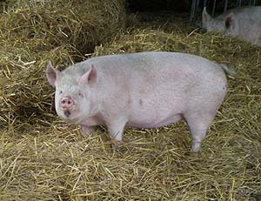
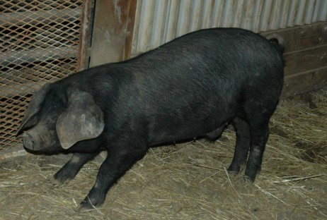
NOW YOU TRY SOME:
1.) In pigs, the white color (W) is dominant; the black color (w) is recessive. Using Punnett squares, show the expected results of the following crosses.

Slide 57
1a) A pure (homozygous) white pig is mated with a black pig.
WW ww
P₁ cross: __ __ x __ __
100% Ww
F₁ G:
F₁ P:
W W
w
w
Ww
Ww
100% White
Ww
Ww

Slide 58
b) Show a cross between two of the F₁ offspring from number 1a. Determine the genotypes and phenotypes of the offspring in the F₂ generations.
Ww Ww
P₁ cross: __ __ x __ __
W w
1WW: 2Ww: 1ww
F₂ G:
F₂ P:
W
w
WW
Ww
3White: 1black
Ww
ww

Slide 59
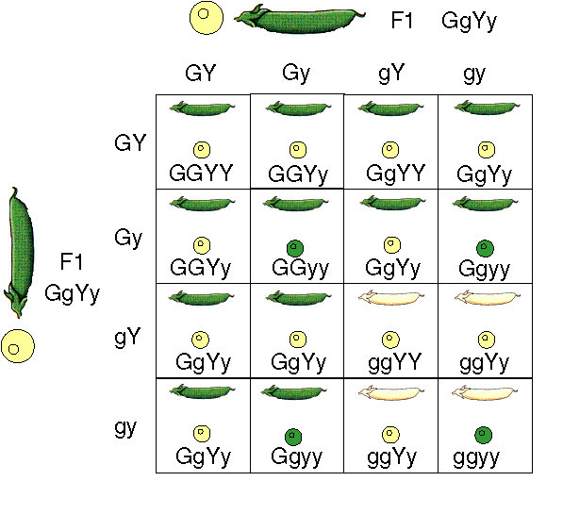
Dihybrids
(two traits)

Slide 60
Dihybrids (two traits)
Because each parent and offspring are using two traits, each one should have 4 alleles, 2 for each trait.
Each gamete produced by the P₁ generations will contain 2 alleles, one for each trait.

Slide 61
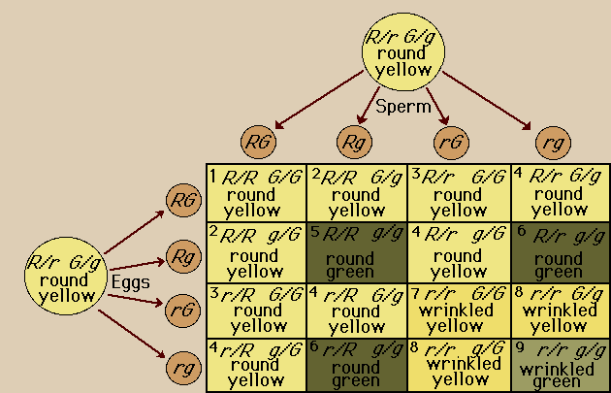
Dihybrid: seed color and shape

Slide 62
Dihybrids (two traits)
Example: A plant that is heterozygous for being tall and having green seeds is crossed with a homozygous yellow and short
        Traits = seed color and plant height
        Alleles G =green T = tall
g = yellow t = short
TtGg ttgg
Cross: _______ x _______

Slide 63
Dihybrids (two traits)
Determine the gametes produced by each parent by using the FOIL method.
(First Outer Inner Last)
  TtGg produces 4 different gametes:
  ttgg produces only 1 gamete:
TG Tg tG tg
tg

Slide 64
TG Tg tG tg
tg
tg
tg
tg
TtGg
Ttgg
ttGg
ttgg
Phenotypes:
4 tall/green seeds
4tall/yellow seeds
4short/green seeds
4short/yellow seeds
Genotypes:
4TtGg:
4Ttgg:
4ttGg:
4ttgg
TtGg
Ttgg
ttGg
ttgg
TtGg
Ttgg
ttGg
ttgg
TtGg
Ttgg
ttGg
ttgg

Slide 65
DIHYBRID (2 traits) HOMEWORK SET
Dihybrid cross (two traits are considered) the number of possible combinations of the offspring increases.
Suppose that black hair (B) is dominant over blonde hair (b) and brown eyes (E) are dominant over blue (e).
What percent of offspring could be expected to have blonde hair and blue eyes if:

Slide 66
DIHYBRID (2 traits) HOMEWORK SET
The father has black hair (heterozygous) and brown eyes (heterozygous) and the mother has blonde hair and blue eyes.
Genotype of father =_________
Genotype of mother =_________
Complete the cross using the Punnett square. Determine what percent of offspring will have blonde hair and blue eyes.
BbEe
bbee

Slide 67
BE Be bE be
be
be
be
be
BbEe
Bbee
bbEe
bbee
25% (4/16)
____________________% blonde hair & blue eyes

Slide 68
DIHYBRID (2 traits) HOMEWORK SET
Both parents have black hair (heterozygous) and brown eyes (heterozygous).
Genotype of father = ________
Genotype of mother = ________
Complete the Punnett square below. Determine what percent of offspring will have blonde hair and blue eyes.
BbEe
BbEe

Slide 69
BE Be bE be
BE
Be
bE
be
BBEE
BBEe
BbEE
BbEe
BBEe
BBee
BbEe
Bbee
BbEE
BbEe
bbEE
bbEe
BbEe
Bbee
bbEe
bbee
6.25% (1/16)
_____________________% blonde hair & blue eyes

