Slide 1
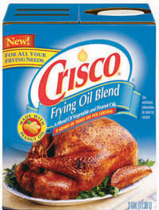
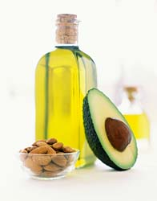
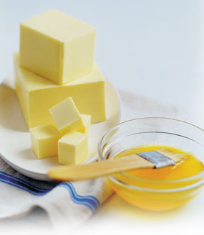
Lipids (fats)
Concentrated energy molecules

Slide 2
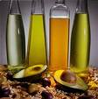
I. LIPIDS:
    Foods: butter, oil, Crisco, lard
Commonly called fats & oils
Contain more C-H bonds and less O atoms than carbohydrates.
  Ex: C₅₇H₁₁₀O₆
Nonpolar; therefore repel water (insoluble)

Slide 3
Functions of lipids in our body:
  Long term energy storage (used when carbohydrates are NOT available)
    Concentrated energy storage’
    Twice the energy of carbohydrates
  Insulation – like whale blubber
  Protect body tissue like your organs (cushioning)

Slide 4
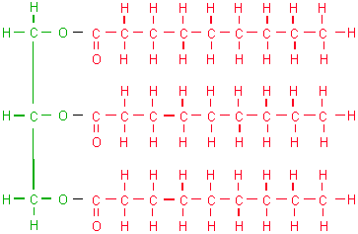
Triglycerides =
Majority of fat in organism consist of this type of fat molecules
  Derived from fats eaten in foods or made in the body from other energy sources like carbohydrates.

Slide 5
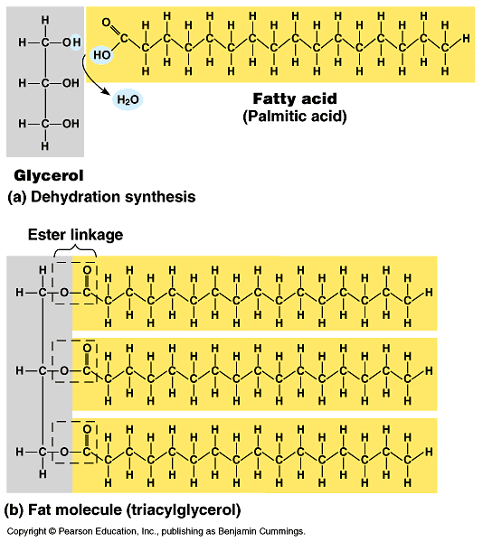
Energy Storage
Calories ingested in a meal that are not burned are turned into triglycerides then stored in fat cells.
Released as energy between meals
                Storage – 3 month supply of energy vs. glycogen’s 24 hour supply

Slide 6
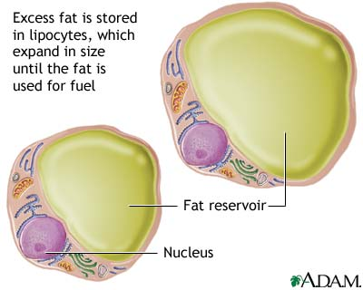
Energy release
            Hormones regulate the release of triglycerides from fat tissue so they meet the body's needs for energy between meals.

Slide 7
WHICH HAS MORE ENERGY – LIPIDS OR CARBS.?
      One gram of fat contains TWICE as much energy as one gram of carbohydrates. Therefore, fats are better storage compounds!

Slide 8
                What happens to lipids in the body?
Broken down by the digestive system via HYDROLYSIS into fatty acids and glycerol which are then absorbed into the body through the bloodstream.
The fatty acids can then be broken down directly to get energy, or can be used to make glucose

Slide 9
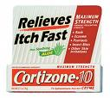
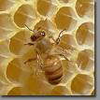
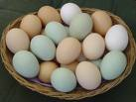
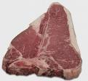

          Types and Examples of Lipids:
Sterols- steroids
Waxes – bee, furniture, ear, car
Cholesterol- in egg yolks, red meat
Fats- from animals
Oils – from plants
Hormones
  sex hormones
    testosterone (male)
    estrogen (female)

Slide 10
Triglyceride
Unsaturated Fat
Saturated Fat

Slide 11
            3 types of fats:
1. Saturated fats = fatty acid chains of carbon with only single bonds between the carbon atoms
  Most animals fats
  “Bad Fats”- cholesterol (heart disease) known as Low Density Lipoproteins
  Solid at room temperature
    Ex: butter

Slide 12
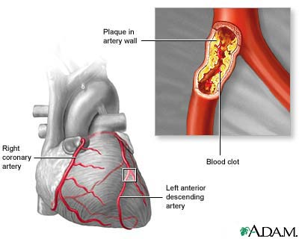
          Excess Triglycerides
Cause plaque to build up
  Arteriosclerosis = walls of the arteries get thick and hard; fat builds up inside the walls and slows the blood flow
    Cause blood clots –heart attacks, strokes
  Hypertension (high blood pressure)

Slide 13
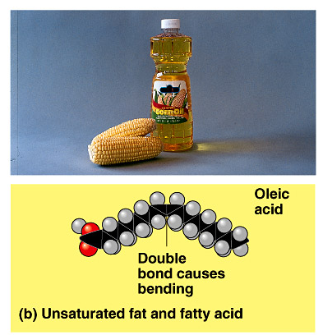
Unsaturated fats =
fatty acid chains of carbon with ONE double bond between the carbon atoms
  “Good Fats” (High density Lipoprotein)
  Plant, vegetable, and fish fats
  Liquid at room temperature
    Ex: Olive oil

Slide 14
Polyunsaturated fats
= MORE THAN ONE double bond between the carbon atoms in the chain
  can help reduce bad cholesterol levels in your blood
  provide nutrients to help develop and maintain your body’s cells
  Oils rich in polyunsaturated fats also contribute vitamin E to the diet, an antioxidant vitamin

Slide 15
Sources of Polyunsaturated fats
soybean oil
corn oil
sunflower oil
fatty fish such as salmon, mackerel, herring and trout.
  provide essential fats such as omega-6 and omega-3 fatty acids which are important for many functions in the body

Slide 16
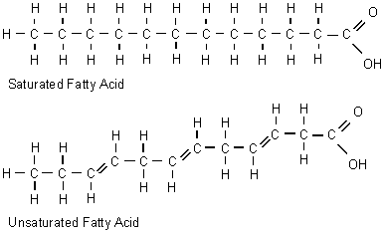
Structural formulas for saturated and polyunsaturated fatty acids:
Single bonds between carbon atoms
Polyunsaturated Fatty Acid
Double bonds between carbon atoms

Slide 17
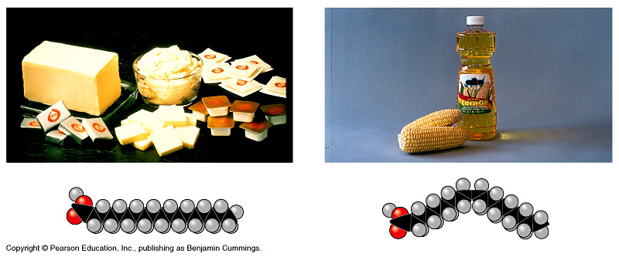
Saturated vs. unsaturated
saturated
unsaturated
✓

Slide 18
Steroids =
a class of lipids that cause changes in organisms and help regulate natural cycles
Functions
  Promotes muscle and bone growth
  Sex hormones
  Metabolism regulation
  Cholesterol is a form of steroid

Slide 19
Steroids: Hormones
Reproductive hormones - help regulate the reproductive cycle in organisms
Sex hormones - help determine the development and physical characteristics of gender
Corticosteroids - help control stress response, immune response, regulation of inflammation and metabolism

Slide 20
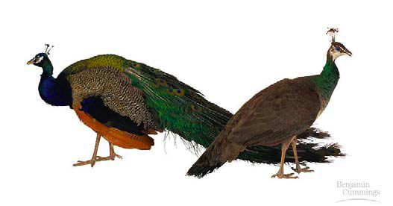
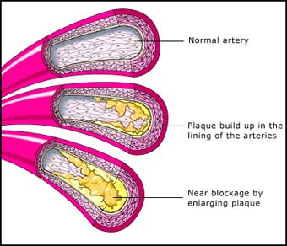
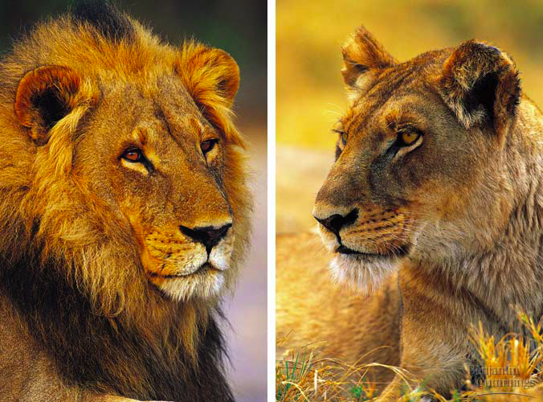
Cholesterol
about 75% made in liver
  good molecule in cell membranes
  make hormones from it
    including sex hormones
  but too much cholesterol in blood may lead to heart disease

Slide 21
Cholesterol
Low density lipoprotein(LDL)
  considered the “bad” cholesterol because it can stick to the internal lining of blood vessels (arteries)
  “plaque” and can impede blood flow and weaken blood
  A heart attack or stroke can occur when the blood flow stops
High density lipoprotein(HDL)
  Cleans walls of arteries
  considered the “good” cholesterol because it can lower LDL levels

Slide 22
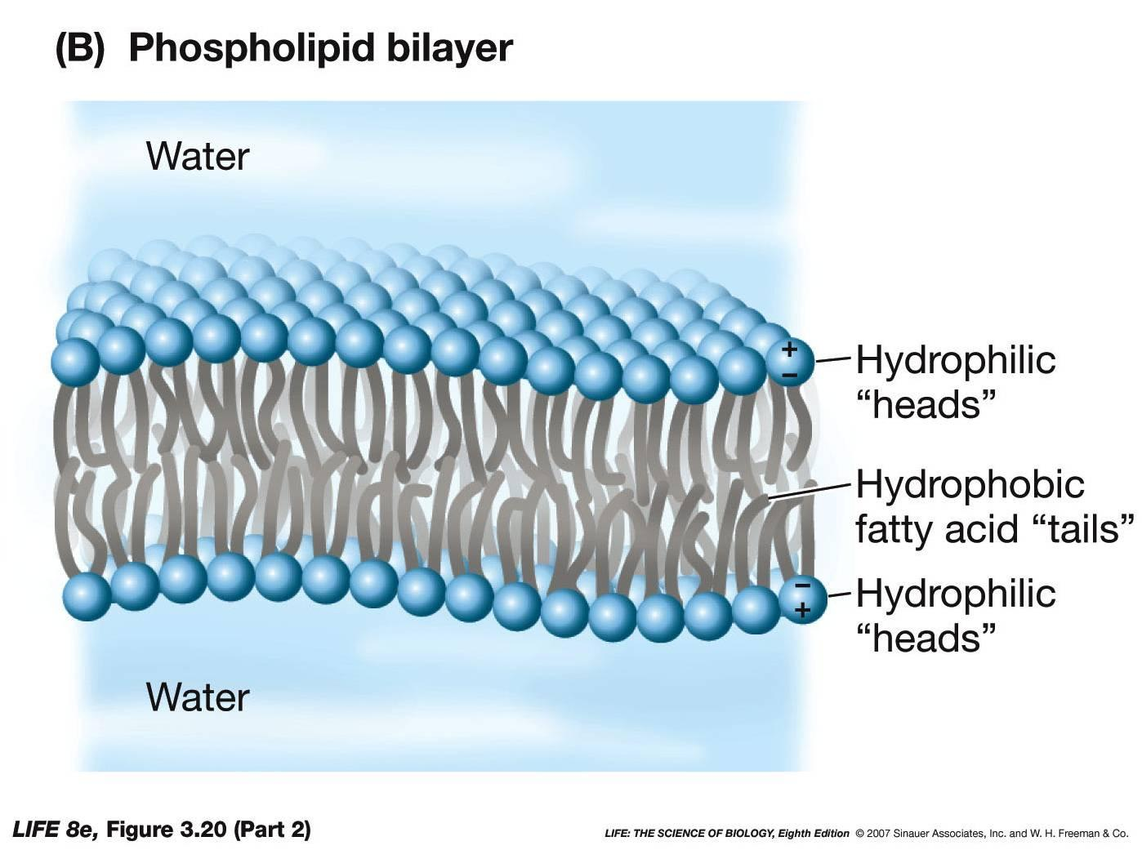
Phospholipids
Class of lipids that compose the cell membrane of organisms
Two parts: a hydrophilic head and two hydrophobic tails
  Phospholipid heads like water
  Phospholipid tails are fatty acids and do not like water
Forms a micelle in water – heads face out while tails face in
In the cell membrane, phospholipids form a lipid bilayer

