Slide 1
Macromolecules Indicators Lab

Slide 2
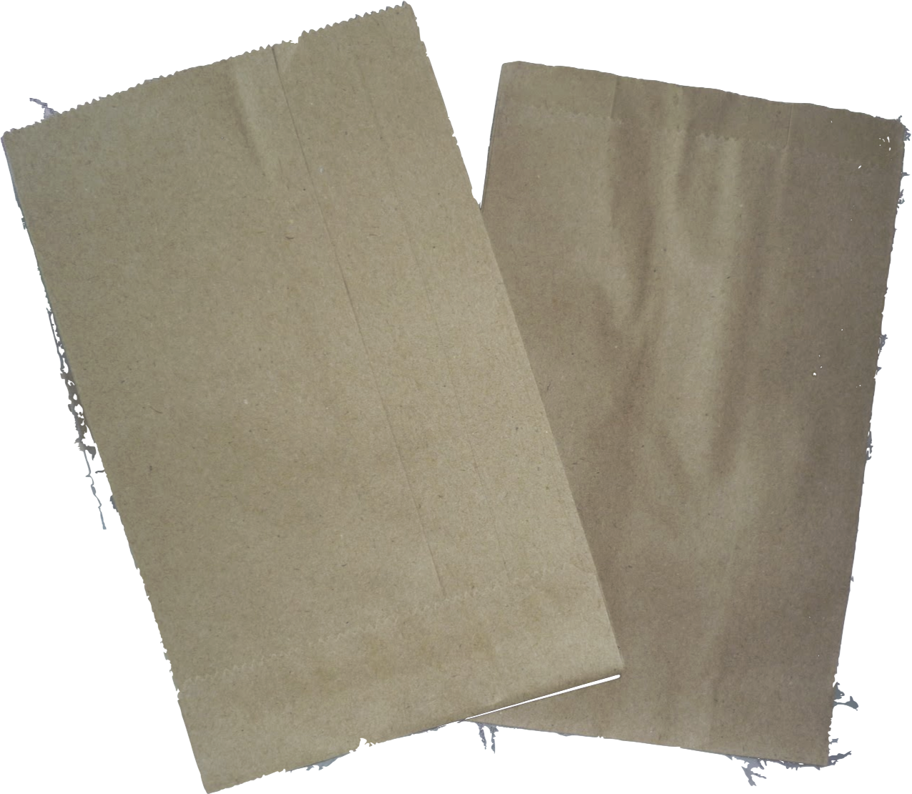
Paper Bag test
Fold a piece of paper into small squares
Label each square with the name of the food sample
Rub a small amount of each solution on the paper
Let the paper dry
Hold the paper up to the light

Slide 3
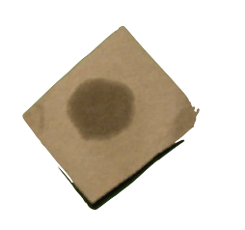
Positive Paper Bag Test
Positive result will cause the paper to become translucent
Light will pass through the paper
Wet paper is not a positive test
If paper stays opaque – the test is negative
Opaque means light does not pass through

Slide 4
Paper Bag test
Remember to throw the pieces of paper away in the trash cans when your group cleans up.
Do no throw the paper around.

Slide 5
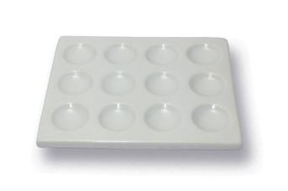
Biuret test
Iodine test
Protein
Glucose
Protein
Glucose
Oil
X
Oil
X
Starch
Starch

Slide 6
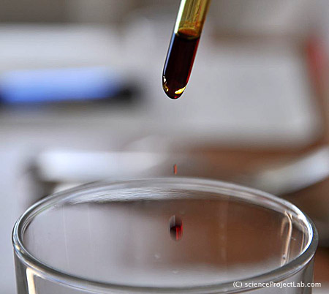
Iodine Test
Place a small amount of each solution in a dimple plate
Add 2 drops of iodine to each of the samples
Observe the color of the iodine and record in the data table

Slide 7
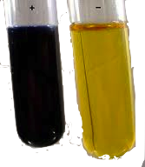
Iodine Test
If it is positive, the iodine will turn a purple/black
If it is negative, the iodine stays yellowish

Slide 8
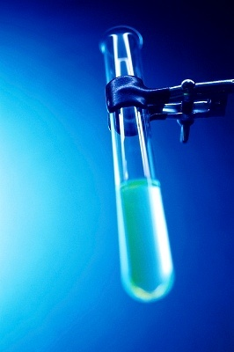
Biuret Test
Place a small amount of each solution in the other part of the dimple plate.
Add 2-3 drops of Biuret to each solution.
Observe any color change and record results in data table

Slide 9
Biuret Test
Biuret solution will change from blue to pink or purple for a positive test
Negative will not change

Slide 10
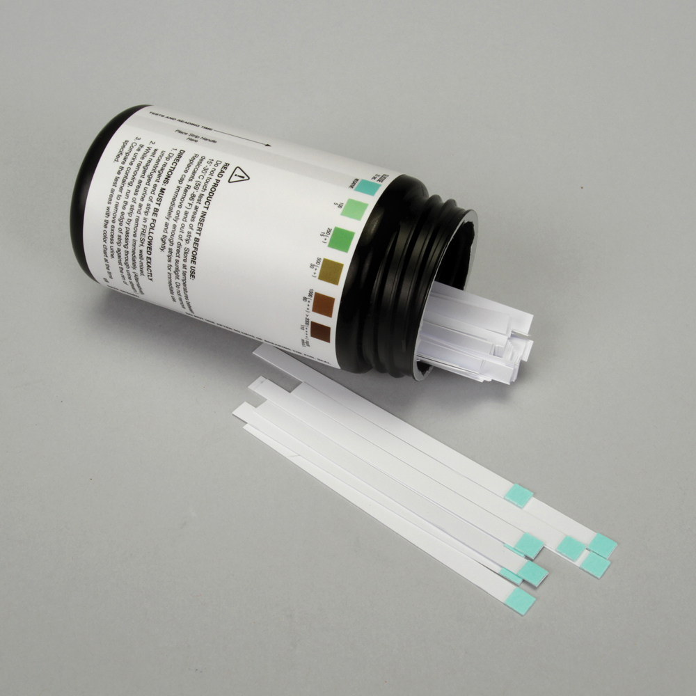
Benedict’s Changed to Test Strips
Get 5 test strips, one for each solution
Use one set of solutions in the dimple plate BEFORE you do the iodine test
Dip green end of each test strip into Protein solution, then set aside and let dry.
Repeat for each of the solutions.
Split data table column in two to record your reslts

Slide 11
Benedict’s Test- Class Demo
Pour 5 mL Benedict’s solution into numbered test tubes with a small amount of each solution
Place the test tubes in a hot water bath, heat for 5 minutes and observe color changes
Record results in data table

Slide 12
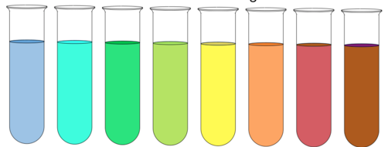
Benedict’s Test
Check the hot water bath to make sure that the temperature is between 40-50 ºC
Keep test tubes in the hot water bath for 5 minutes and then remove and record your results.

Slide 13
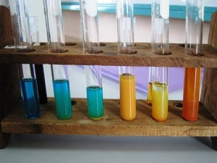
Positive Results for Benedict’s
Positive result changes from blue to green to orange or even red
Negative does not change color

