Slide 1
Catalyst #1
What are the stages of mitosis, in order?
In which phase do chromosomes line up at the equator of a cell?
If a parent cell has 46 chromosomes and it goes through cell division, how many chromosomes will the daughter cells have?

Slide 2
Meiosis
Division of sex cells

Slide 3
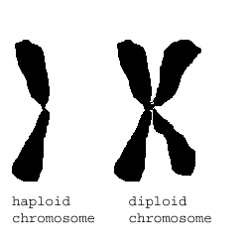
MEIOSIS VOCABULARY:
Diploid = a cell containing TWO sets of chromosomes.
    one set inherited from each parent
    2n (number of chromosomes)
    body cells (somatic cells)

Slide 4
MEIOSIS VOCABULARY:
  Haploid = a cell with only ONE set of chromosomes.
    1n (number of chromosomes)
    sex cells (gametes)

Slide 5
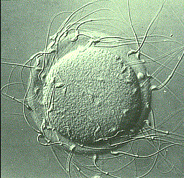
MEIOSIS VOCABULARY:
Gamete= sex cells
  Sperm = male gamete
  Egg = female gamete

Slide 6
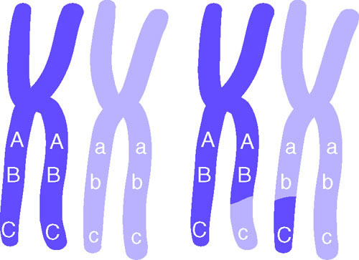
MEIOSIS VOCABULARY:
Homologous chromosomes = paired chromosomes that have genes for the same traits arranged in the same order.
  One homologous chromosome is inherited from the organism’s father, the other from the mother.

Slide 7
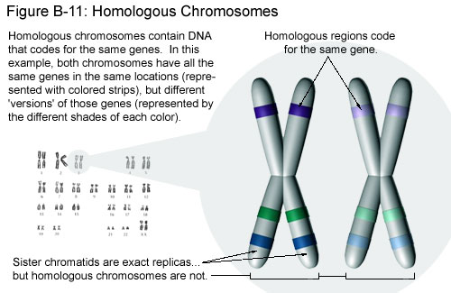

Slide 8
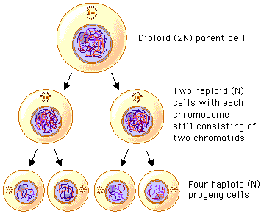
MEIOSIS VOCABULARY:
  Meiosis = a two stage type of cell division that results in gametes with half the number of chromosome number as the body cells.

Slide 9
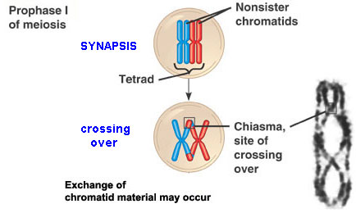
MEIOSIS VOCABULARY:
  Crossing over = when nonsister chromatids of homologous chromosomes exchange genetic information, results in a new combination of genes.

Slide 10
MEIOSIS VOCABULARY:
Fertilization = the process of joining gametes.
Zygote = when sperm (haploid) fertilizes the egg (haploid), the resulting cell is the zygote (diploid).

Slide 11

I. Genes, chromosomes, and numbers:
In humans, each somatic cell (any cell other than a sperm or egg, has 46 chromosomes)

Slide 12
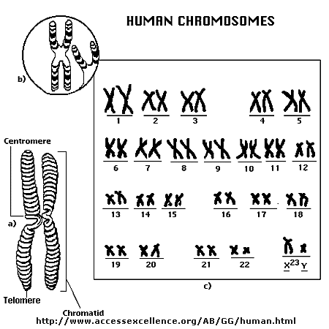
    46 chromosomes→ 23 pairs (humans get 1 pair from each parent)

Slide 13
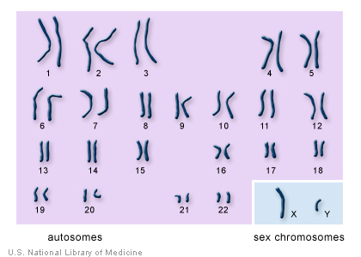
Sex chromosomes- determine the sex of an individual
  last pair of chromosomes—23rd pair for humans
XX = female
XY = male

Slide 14
The number of chromosomes for an organism is NOT related to the complexity of that organism!!
    Ex: A dog has 78 body chromosomes and humans have 46 body chromosomes
A thousand or more genes are lined up on a chromosomes at one time

Slide 15
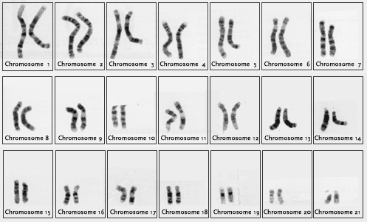
Diploid & Haploid Numbers
      Each somatic cell of an organism contains paired chromosomes.

Slide 16
Half of each pair came from each parent. These cells are said to have 2n chromosomes, or a full set.
  They are DIPLOID
      Ex: Humans have 46 body chromosomes

Slide 17
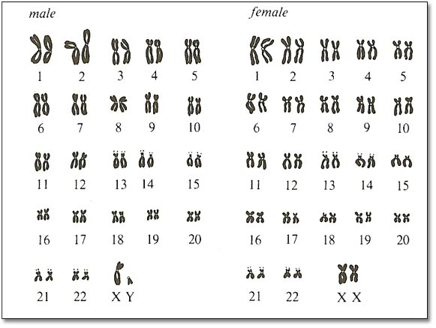

Slide 18
Each sex cell of an organism contains only half of a chromosome set.
    These cells are HAPLOID and have 1n chromosomes
        Ex: Humans have 23 chromosomes in their gametes (egg or sperm cell)

Slide 19
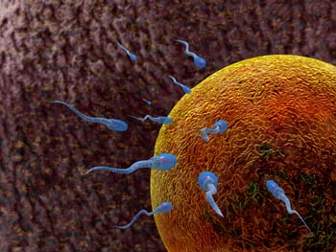
Sex cells will fuse with another sex cell during fertilization to create a 2n organism.

Slide 20
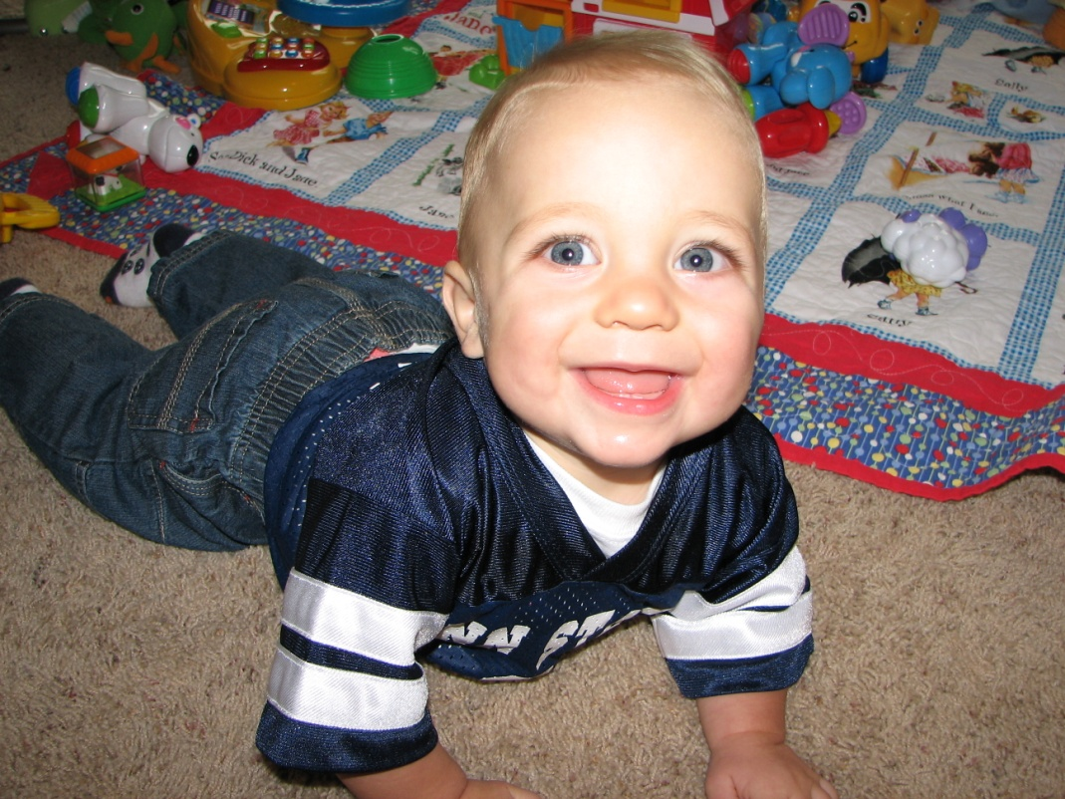
  So if human sperm and egg both have 23 chromosomes, after fertilization an embryo would have 46 chromosomes!

Slide 21
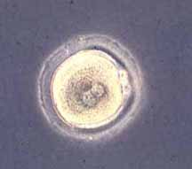
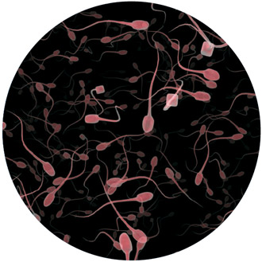
2 Reasons why Meiosis is significant!!
1. Meiosis is another form of cell division that creates haploid cells to be used for reproduction
Female Egg Cell
Male Sperm Cells

Slide 22
2 Reasons why Meiosis is significant!!
If mitosis was the only form of cell division, then new offspring would always have 2 times as many chromosomes as their parents.

Slide 23
2 Reasons why Meiosis is significant!!
Eventually, there would be so many chromosomes, the organism would not survive or be severely mutated.

Slide 24
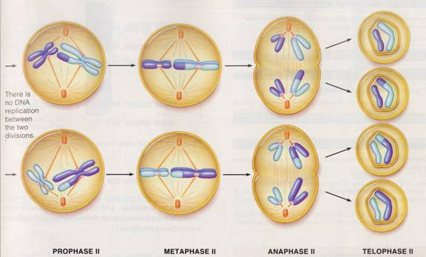
2 Reasons why Meiosis is significant!!
2. Meiosis provides Genetic variation- the reshuffling of genes carried by the individual members of a population.

Slide 25
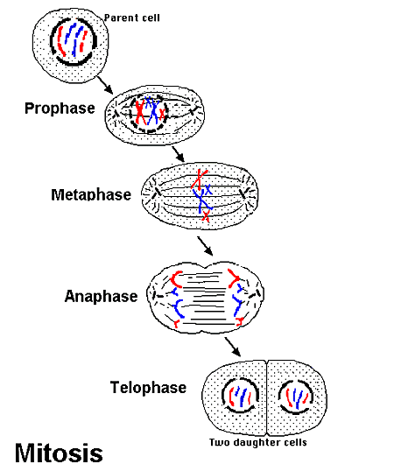
Ii. Meiosis vs. Mitosis:
Remember: mitosis = asexual division of diploid body cells

Slide 26
Ii. Meiosis vs. Mitosis:
 | Meiosis | Mitosis
Cell type of parent | diploid | diploid
Number of daughter cells produced | 4 | 2
Number of cell divisions | 2 | 1
Genetic relationship of daughter cells to parent cell | different | identical
Genetic relationship of daughter cells to one another | different | identical

Slide 27
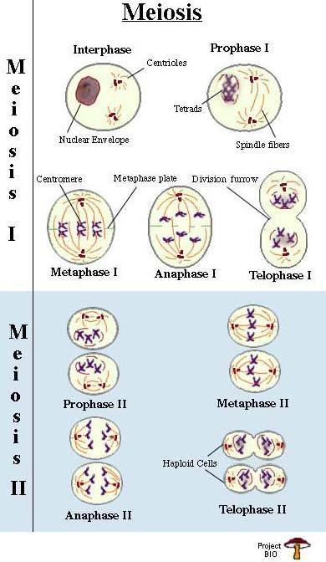

Slide 28
Meiosis I
Separates homologous pairs of chromosomes, not sister chromatids of individual chromosomes.

Slide 29
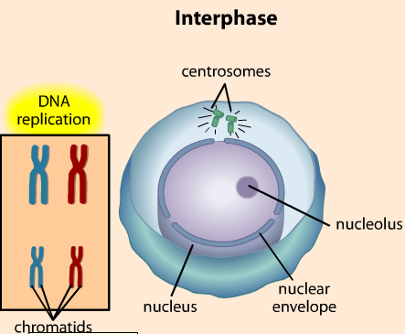
Interphase I
Metabolic activities & replicate chromosomes

Slide 30
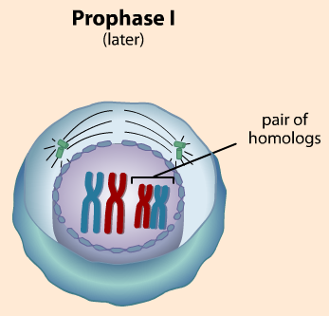
Prophase I
Synapsis occurs- the pairing of homologous chromosomes
Each pair of homologous chromosomes come together to form a tetrad (4 part structure)

Slide 31
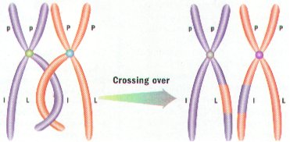
Genetic material is exchanged in a process called crossing over (swapping portions of adjacent DNA)
    Must be done with great precision so that neither chromatid gains or loses any genes!

Slide 32
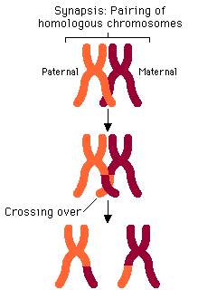
Crossing Over:

Slide 33
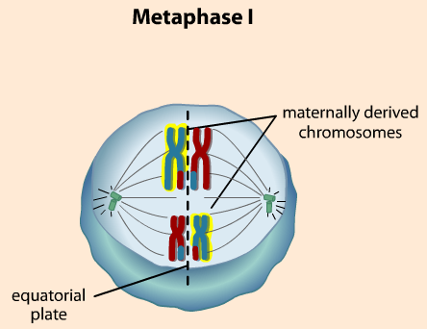
3. Metaphase I
Homologous chromosomes line up at the equator in pairs

Slide 34
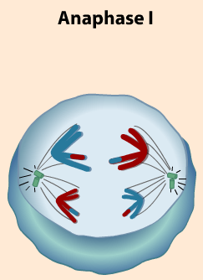
4. Anaphase I
Homologous chromosomes separate and move to opposite ends of the cell.
    This occurs because the centromeres do NOT split like in mitosis

Slide 35
4. Anaphase I
This ensures that each new cell will receive only one chromosome for each homologous pair.

Slide 36
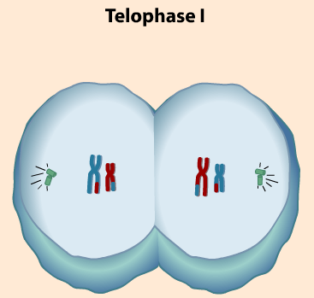
5. Telophase I
The new cells are diploid so another division is required to create haploid cells

Slide 37
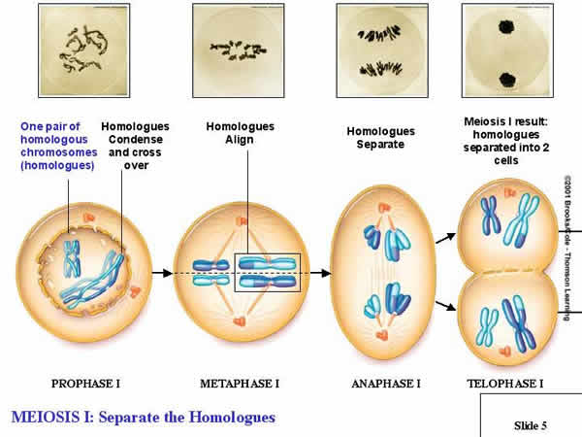
Meiosis I: Separate the Homologues

Slide 38
Meiosis II
The mechanisms of Meiosis II is almost the same as mitosis
      However, the chromosomes DO NOT replicate between meiosis I and meiosis II, the final outcome of meiosis is halving the number of chromosomes per cell.

Slide 39
1. Interphase II
No replication
Allows the new cells to become haploid

Slide 40
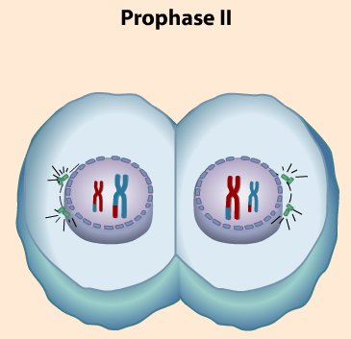
2. Prophase II
Same as Prophase I except NO tetrads are formed

Slide 41
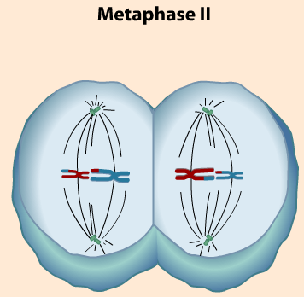
3. Metaphase II
Chromosomes line up at the equator

Slide 42
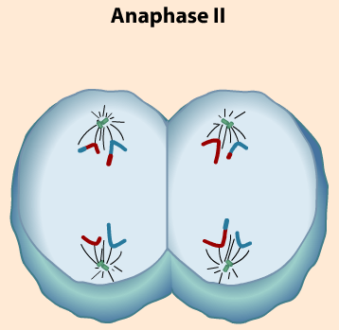
4. Anaphase II
    Sister chromatids move to the opposite ends of the cell

Slide 43
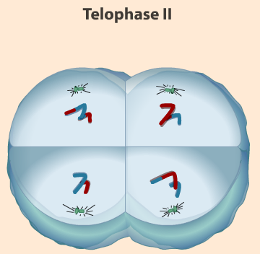
5. Telophase II
Creates 4 haploid cells (gametes)

Slide 44
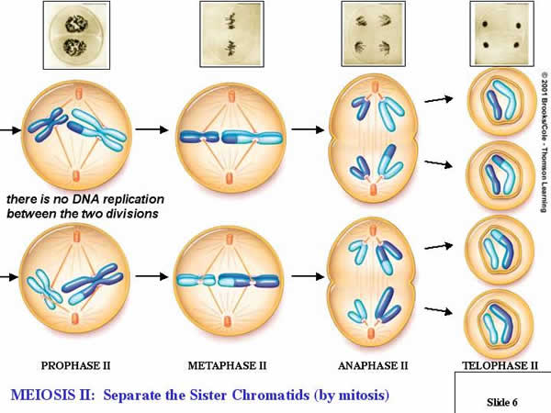
But wait..there's more! Meiosis II: Separate the Sister Chromatids

Slide 45
Meiosis Animation- w/ sound
http://www.sumanasinc.com/webcontent/animations/content/meiosis.html

Slide 46
Meiosis provides genetic variation in 2 ways
  Independent assortment of homologous chromosomes during meiosis I
      The amount of different chromosomes that can be produced increases greatly as the number of chromosomes an organism has.

Slide 47
Meiosis provides genetic variation in 2 ways
      A pea plant has 7 pairs of chromosomes. Each pair can line up 2 different ways. Therefore, each gamete can have 2⁷= 128 possibilities!!
      Humans: n=23; so the number of different kinds of eggs or sperms a person can produce is more than 8 million (2²³)

Slide 48
Meiosis provides genetic variation in 2 ways
When fertilization occurs, 2²³ X 2²³ zygotes are possible or 70 trillion!!
  No wonder brothers and sisters can be so different.

Slide 49
Meiosis provides genetic variation in 2 ways
  Crossing over between homologous chromosomes during prophase of meiosis I
    Increases the number of genetic variations

Slide 50
Meiosis is NOT flawless
    It is estimated that from 10–20% of all human fertilized eggs contain chromosome abnormalities, and these are the most common cause of pregnancy failure (35% of the cases).

Slide 51
These chromosome abnormalities:
Arise from errors in meiosis, usually meiosis I
Occur more often (90%) during egg formation than during sperm formation
Become more frequent as a woman ages.

Slide 52
Meiosis Animation- no sound
http://www.johnkyrk.com/meiosis.html

Slide 53
