Slide 1
Vocab/Reading Activity Read pages 270-276
Meiosis
Read the paragraphs and when you see the following terms, copy down their definitions and answer the questions

Slide 2
Standard- Diversity, Genetics, and Evolution: Understand genetics and biological evolution and their impact on the unity and diversity of organisms
Why are genes important?
What are Homologous chromosomes. Why are they important?
Gametes
Fertilization
Why is meiosis referred to as reduction division?
What happens when gametes combine in fertilization? Draw Figure 10.2
Crossing over- give the definition and draw Figure 10.4
How many divisions does meiosis have? Why is Meiosis important?
Why is reproducing sexually more beneficial that reproducing asexually?
Draw Meiosis stages on page 273. Draw each stage’s diagram, label, and describe what is happening in each stage.

Slide 3
Why are genes important? They play an important role in determining the characteristics and functions of the cell.
What are Homologous chromosomes. Why are they important? Chromosomes that make up a pair (1 from each parent). They are important bc they carry genes that control the same inherited traits.

Slide 4
Gametes – sex cells that have half the number of chromosomes (23 for humans which is half of 46)
Fertilization – process by which one haploid gamete combines with another haploid gamete
Why is meiosis referred to as reduction division? Bc it is cell division that reduces the number of chromosomes. (for humans 46 to 23)

Slide 5
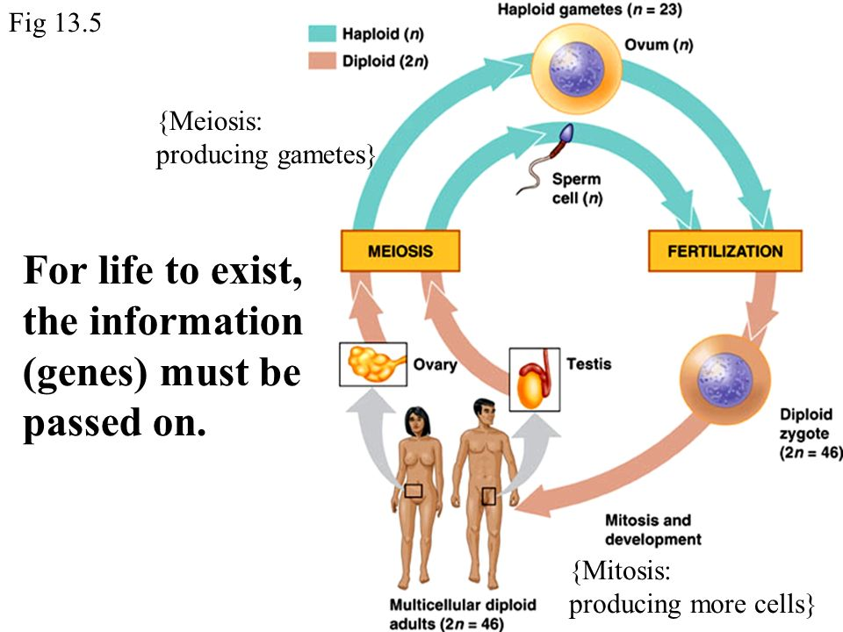
What happens when gametes combine in fertilization? Draw Figure 10.2
The cell now contains a total of 2n chrmomosomes (n from mom and n from dad equals 2n) a cell that is 2n is

Slide 6
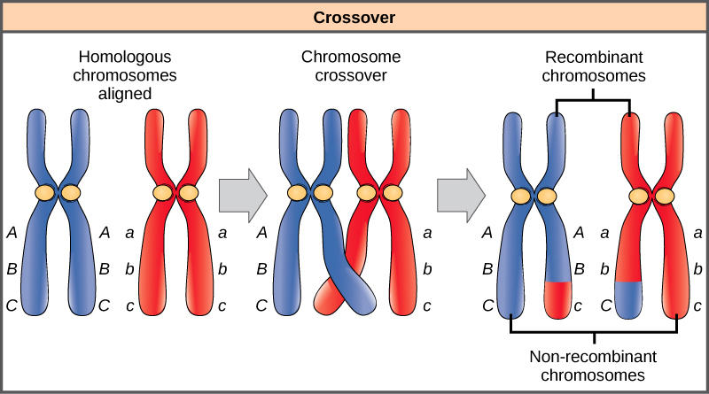
Crossing over- give the definition and draw Figure 10.4 A process during which chromosomal segments are exchanged between a pair of homologous chromosomes
How many divisions does meiosis have? Why is Meiosis important? 2 divisions, it is important bc it results in genetic variation. Without meiosis the number of chromosomes of the offspring would also be too great.

Slide 7
Why is reproducing sexually more beneficial that reproducing asexually? Sexual reproduction accumulates beneficial mutations faster than asexually reproducing. When reproducing sexually, the beneficial genes multiply faster over time.
Draw Meiosis stages on page 273. Draw each stage’s diagram, label, and describe what is happening in each stage.

Slide 8
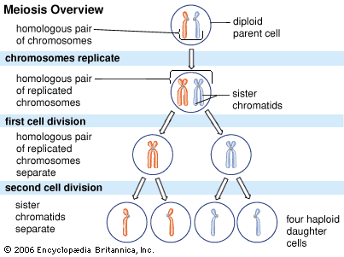
Meiosis

