Slide 1
Patterns of Heredity

Slide 2

Not all traits are simply inherited by dominant and recessive alleles (Mendelian Genetics).
In some, neither allele is dominant or many alleles control the trait.

Slide 3
5 Different Modes of inheritance

Slide 4

1. Incomplete dominance
Definition:
    Neither allele for a gene dominates
    Phenotype of the heterozygous offspring will be a blend of the 2 homozygous parents.
Homozygous Parent
Heterozygous Offspring
Homozygous Parent

Slide 5
Incomplete dominance
      Ex: A homozygous white flower crossed with a homozygous red flower will produce all heterozygous pink flowers.
Homozygous Parent
Heterozygous Offspring
Homozygous Parent

Slide 6
Incomplete dominance
Notation:
    Alleles are all capital letters because neither one dominates the other. So one of the alleles has a prime ( ‘ ) on it to represent an alternate expression of the gene.

Slide 7
  Always make a KEY to show the genotypes and the resulting phenotypes.
  Still supports Mendel’s Law of Independent Assortment

Slide 8

Ex. 1) In a certain species of flowers, snapdragons, the combined expression of both alleles for flower color produces a new phenotype-pink.
A red snapdragon is homozygous and is crossed with a homozygous white snapdragon. What are the genotypic and phenotypic ratios of this cross?

Slide 9

Key:
Red = RR
White=R’R’
Pink = RR’
P cross = RR x R’R’
R R
G: 100% RR’
P: 100% PINK
R’
R’
RR’
RR’
RR’
RR’

Slide 10
Ex. 2) Then cross the F₁ generation and what are the genotypic and phenotypic ratios of this cross?

Slide 11
Key:
Red = RR
White=R’R’
Pink = RR’
P cross = RR’ x RR’
G: 1RR:2RR’:1R’R’
P: 1Red:2Pink:1white
R R’
R
R’
RR
RR’
RR’
R’R’

Slide 12
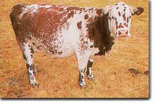
2. CoDominance
Definition:
  Both alleles are expressed EQUALLY

Slide 13
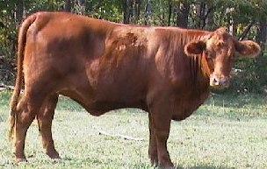
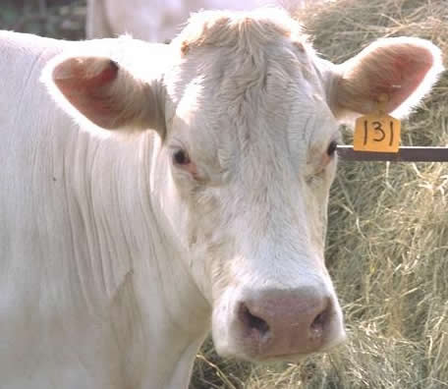
CoDominance
  Phenotypes of heterozygous offspring are showing both traits!
    Ex: red cows crossed with white will generate roan cows. Roan refers to cows that have red coats with white blotches.
X
=

Slide 14
CoDominance
Notation:
  2 different alleles (capital letters) are used
  Always make a KEY to show the genotypes and the resulting phenotypes

Slide 15
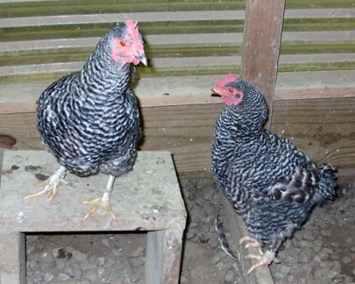
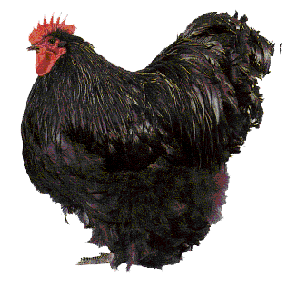
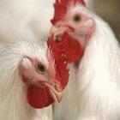
In chickens, black-feathered is not wholly dominant over white-feathered, so heterozygous chickens are black and white checkered. Cross two heterozygous chickens. What would the appearance of their offspring be?

Slide 16
Key:
Black= BB
White= WW
Checkered= BW
P cross = BW x BW
Phenotype:
1Black:
2 Checkered:
1white
B W
B
W
BB
BW
BW
WW

Slide 17
In shorthorn cattle, the hybrid between red and white is called a roan. What phenotypes would result in the cross of a roan and a white?

Slide 18
Key:
Red= RR
White= WW
Roan= RW
P cross= RW x WW
Phenotype:
2 Roan: 2 white
R W
W
W
RW
WW
RW
WW

Slide 19
3.Multiple alleles
Definition:
  More than 2 alleles for a single gene can control a trait.
Multiple alleles must be studied by looking at the entire population of species.

Slide 20
Multiple alleles
Each individual carries only 2 alleles for any gene (one on each homologous chromosome).
  In this form of inheritance, a trait can have 1 gene, but 100 alleles for that gene.

Slide 21

Multiple alleles
Ex: The human blood group can be any combination of A, B,
and O

Slide 22
Multiple alleles
  The alleles are I^{A}, I^{B}, and i
    Alleles A and B are CODOMINANT
    Alleles i (“O”) is recessive

Slide 23
Notation:
  The possible genotypes/phenotypes:
GENOTYPES |  | PHENOTYPES
Homozygous type A | I^{A}I^{A} | type A blood
Heterozygous type A | I^{A}i | type A blood
Homozygous type B | I^{B}I^{B} | type B blood
Heterozygous type B | I^{B}i | type B blood
Codominant type AB | I^{A}I^{B} | type AB blood
Recessive type O | ii | type O blood

Slide 24
Multiple alleles
  NOTE: the “i” is dropped from the genotype of A and B when the phenotype is written.
  (Genotype I^{A}i is type A blood)

Slide 25

Interesting fact:
In the U. S., about 45% of the population is type O, 42% type A, 10% type B, and only 3% type AB.

Slide 26
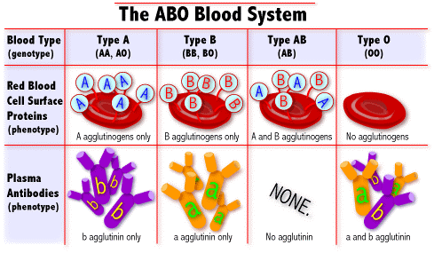

Slide 27
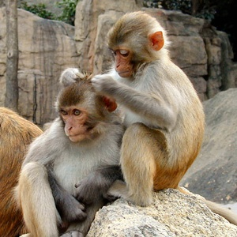
The positive and negative of a blood type is called the Rh factor, it is a totally separate gene with Rh⁺ (RR or Rr) and Rh–alleles (rr)
  If you have the protein = Rh +
  If you DO NOT have the protein = Rh –

Slide 28
In the U. S., about 85% of the population is Rh⁺ and 15% Rh–.
Thus the chances of someone being O- [having both ii and rr] would be 45% × 15% = 6.75%.

Slide 29
The most rare blood type would be AB-, about 0.45% of the population.
    O is the universal donor
    AB is the universal receiver

Slide 30

1) If a person of blood group AB marries one belonging to group O, what could be the possible genotypes and phenotypes of their offsprings’ blood types?

Slide 31
P cross = I^{A}I^{B} x ii
I^{A} I^{B}
Genotypes:
2 I^{A}i : 2 I^{B}i
Phenotypes:
2 Type A: 2 Type B
i
i
I^{A}i
I^{B}i
I^{A}i
I^{B}i

Slide 32
If a father is homozygous blood type A and the mother is heterozygous blood type B. What could be the possible genotypes and phenotypes of their offspring’s blood types?

Slide 33
P cross = I^{A}I^{A} x I^{B}i
I^{A} I^{A}
Genotypes:
2 I^{A}i : 2 I^{A}I^{B}
Phenotypes:
2 Type A: 2 Type AB
I^{B}
i
I^{A}I^{B}
I^{A}I^{B}
I^{A}i
I^{A}i

Slide 34
2 Types of Chromosomes:
1. Sex chromosomes- last pair of chromosomes—23rd pair for humans
XX = female
XY = male

Slide 35
2. Autosomal chromosomes or Autosomes
All other pairs of chromosomes – 1 -22nd pair in humans

Slide 36

4. Sex-linked traits
(x-linked)
Other genes besides the alleles for sex are located on the sex chromosomes.

Slide 37

Definition:
These traits will occur MORE frequently in males than females, such as color blindness and hemophilia.

Slide 38
WHY?
  Alleles for a gene may be present on the X chromosome but absent on the Y. These are called sex-linked genes.

Slide 39
  This means that males may inherit just one allele for a characteristic and that allele will be expressed, whether it is dominant or recessive, because it is the only allele present on their X chromosome.

Slide 40
  X-linked traits most likely will be recessive to the normal condition and the Y chromosome lacks the gene for a trait, so males have a higher chance of having the disorder.

Slide 41
These traits generally do NOT show up in females since females have genes on both their X chromosomes.

Slide 42
Notation:
  The alleles for these traits are written as superscripts on the X chromosome ONLY.

Slide 43
No alleles are written on the Y chromosome!
  Ex: Colorblind male = X^{b}Y and Normal male = X^{B}Y
Heterozygous Females are known as carriers, X^{B}X^{b}

Slide 44
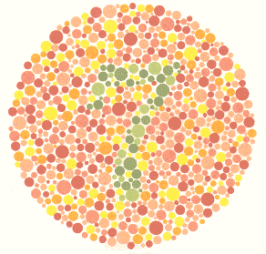
Ex.1) Color blindness is a sex-linked trait that is caused by a recessive allele. A colorblind man marries a woman that is homozygous for normal vision.

Slide 45
P cross X^{N}X^{N} x X^{n}Y
What possible types of vision could be found if they had boys?
X^{N} X^{N}
Normal
X^{n}
Y
X^{N}X^{n}
X^{N}X^{n}
What possible types of vision could be found if they had girls?
X^{N}Y
X^{N}Y
Normal

Slide 46
Ex.2) A girl of normal vision, whose father was colorblind, marries a colorblind man. What types of vision could be found in their children?

Slide 47
P cross = X^{N}X^{n} x X^{n}Y
What types of vision could be found in their children?
X^{N} X^{n}
50% Normal vision
and 50% colorblindness
X^{N}X^{n}
X^{n}X^{n}
X^{n}
Y
X^{N}Y
X^{n}Y

Slide 48

5. Polygenic inheritance
Traits are determined by many genes
They may or may not be found on the same chromosome
Each gene may have more than 2 alleles

Slide 49

The phenotypes may vary depending on the number of dominant and recessive alleles in the genotype

Slide 50

Traits that show great variability are a result of polygenic inheritance
  Ex: eye color, skin color, height, facial features

Slide 51
Environment & genes
The environment can determine whether or not a gene is fully expressed or expressed at all.

Slide 52

Internal and external environments can affect phenotypes:
1. Influence of internal environment:
~ Hormones based on sexes (testosterone, estrogen)

Slide 53



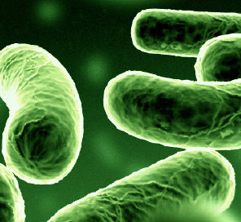

2. Influence of external environment:
~Temperature
~Light
~Infectious agents (viruses, bacteria)
~Chemicals
~Nutrition

Slide 54

All of these can influence the expression of genes.

